Slide 1


Implementation of Chatbot using NLP
Name: Harshal S. Ninawe
Student ID: STU66a3fb2277da21722022690
Email: harshalninawe12@gmail.com

Slide 2

Learning Objectives
Understanding Natural Language Processing (NLP)
Chatbot Development
Machine Learning Implementation
Data Handling & Intent Recognition
User Interaction & UI Design
Conversation Logging & Data Storage
Problem-Solving & Debugging
AI in Healthcare
GOAL
Source :
www.freepik.com/

Slide 3
Tools and Technology used
Programming Language – Python
Framework & UI – Streamlit
Natural Language Processing (NLP) – NLTK
Machine Learning Algorithm – Logistic Regression
Feature Extraction – TF-IDF Vectorization
Data Handling – JSON and CSV
Libraries Used:
sklearn – For implementing machine learning models
random – For generating varied chatbot responses
json – For reading and processing intent data
datetime – For timestamping conversations
nltk – For tokenization and text processing
Development Environment – Jupyter Notebook / VS Code

Slide 4
Methodology
1.
2.
3.
Data Collection & Preprocessing
Feature Extraction
Model Training
6.
5.
4.
Testing & Improvements
Conversation Logging & Data Storage
Chatbot Development & Implementation

Slide 5
Problem Statement:
Access to quick and reliable healthcare information is essential, but long waiting times and misinformation often create challenges. This AI-powered healthcare chatbot provides instant responses to health-related queries using Natural Language Processing (NLP) and Machine Learning (ML). It enhances accessibility by offering accurate guidance, reducing dependency on human support for initial medical assistance.

Slide 6
Solution:
The AI Healthcare Chatbot is designed to provide instant and accurate responses to user queries using Natural Language Processing (NLP) and Machine Learning (ML). It classifies user inputs based on predefined intents and generates relevant responses using a trained Logistic Regression model. Built with Streamlit, the chatbot offers a user-friendly interface for seamless interaction. Additionally, it logs conversations for future analysis and improvements. By offering 24/7 assistance, the chatbot enhances accessibility to healthcare information, reduces misinformation, and minimizes dependency on human intervention for basic medical queries.

Slide 7
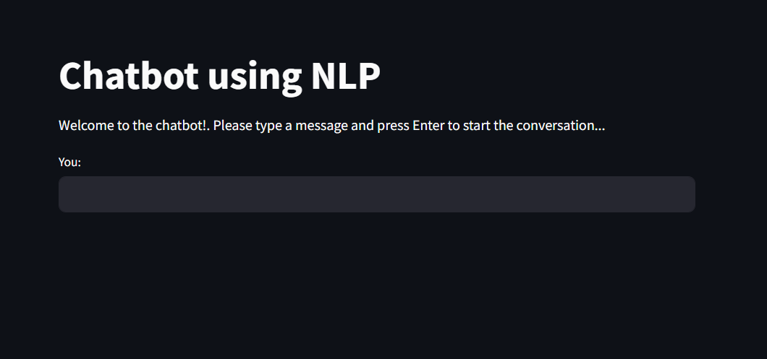
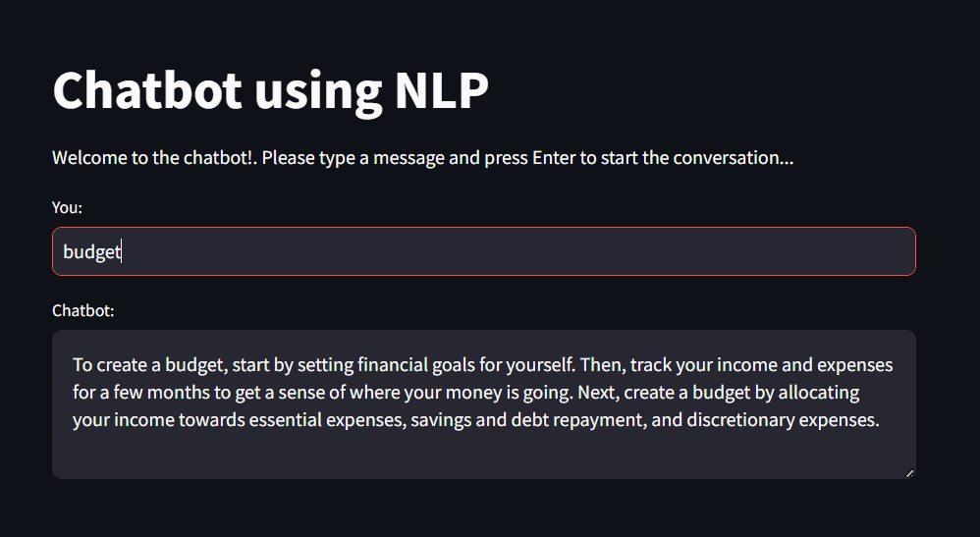
Screenshot of Output:

Slide 8
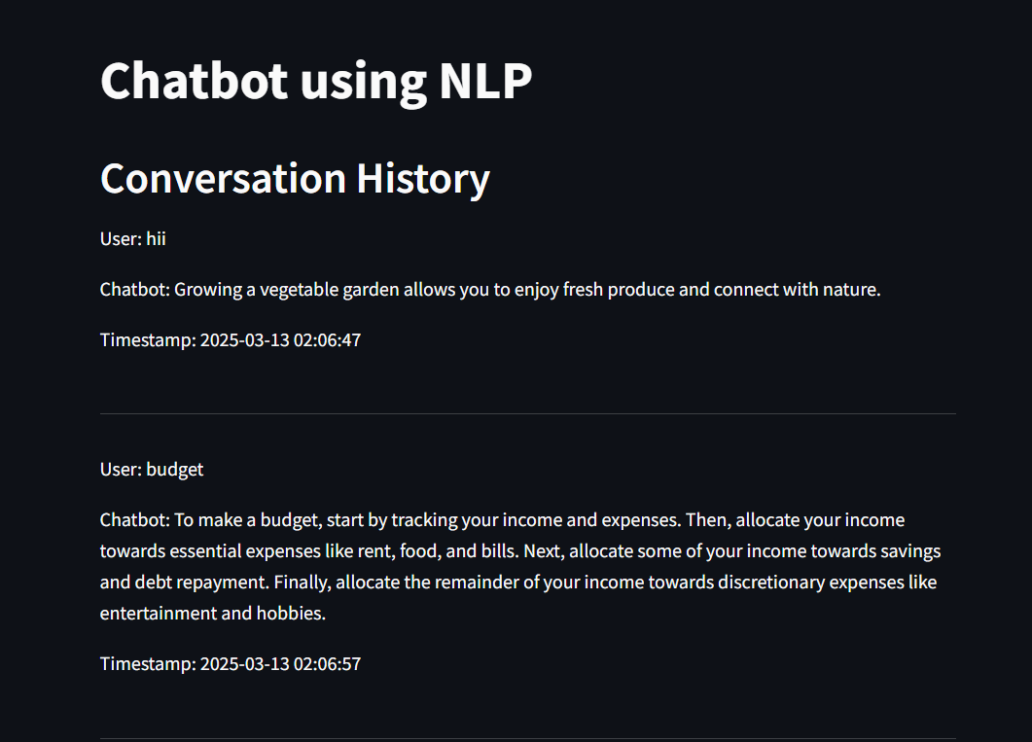
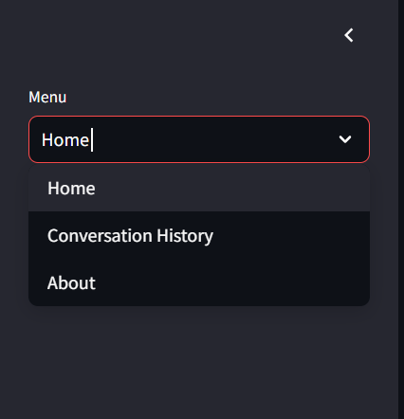
Screenshot of Output:

Slide 9
Conclusion:
The AI Healthcare Chatbot efficiently provides quick and reliable responses to health-related queries using NLP and Machine Learning. By leveraging Logistic Regression for intent classification and Streamlit for an interactive UI, it ensures a seamless user experience. The chatbot enhances accessibility, reduces misinformation, and offers 24/7 assistance. Future improvements can include expanding the intent dataset, integrating real-time medical databases, and implementing voice interaction for a more advanced and user-friendly system.
LINK :
https://github.com/the-money-19/Chatbot_using_NLP.git

